Slide 1
Week 10
Assignment：Three Methods
Name：张颜兵
Id：12132428
Department：MAE
SuperVisor：Prof.吴雷
Research Topic：Engineering calculation

Slide 2
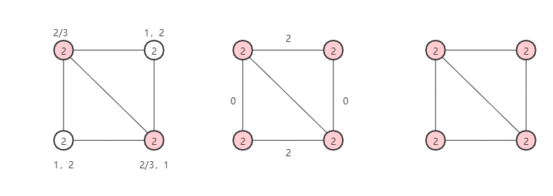

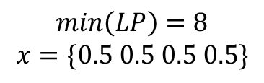

E1 Greedy Set Cover Algorithm
$$\min\left(Greedy\right)=4$$
$$\min\left(Price\right)=8$$
$$\min\left(LP\right)=8$$
$$x=\{0.5 0.5 0.5 0.5\}$$

Slide 3
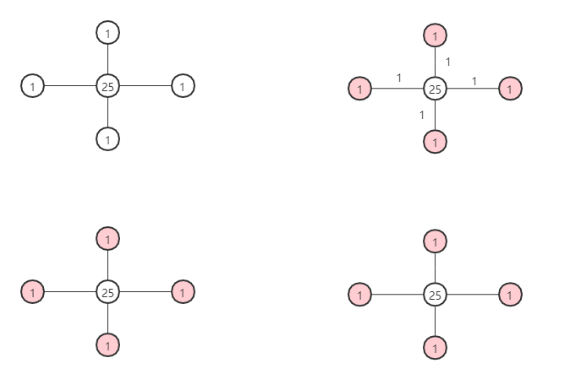

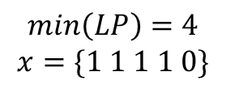

E2 Pricing Method
$$\min\left(Price\right)=4$$
$$\min\left(Greedy\right)=4$$
$$\min\left(LP\right)=4$$
$$x=\{1 1 1 1 0\}$$

Slide 4
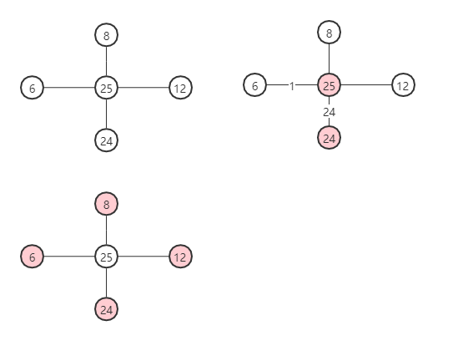
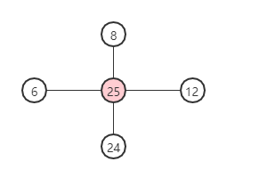


E3 LP-based Method
$$\min\left(LP\right)=25$$
$$\min\left(Price\right)=49>\min\left(Greedy\right)=50$$

